Slide 1
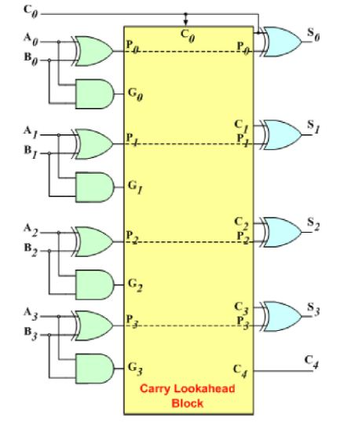
Demystifying Speed: Exploring the 4-Bit Carry Lookahead Adder
Introduction to advanced adder architectures for faster arithmetic operations
EEM410 - IC DESIGN
SAMET BAYAT - 22293730 RAMAZAN ALPER - 22098516
NAZIM

Slide 2
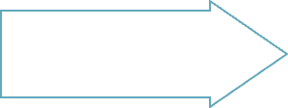
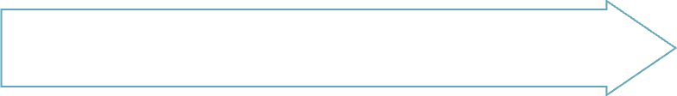
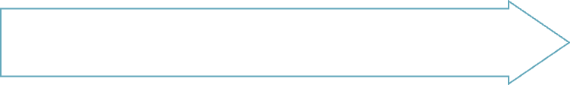
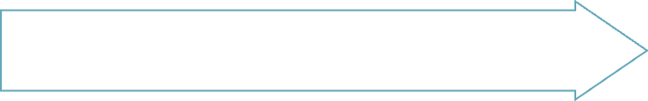
Ripple carry adder speed
Carry lookahead adder speed
The Need for Speed
Faster adders benefit
Processing speed increase

Slide 3
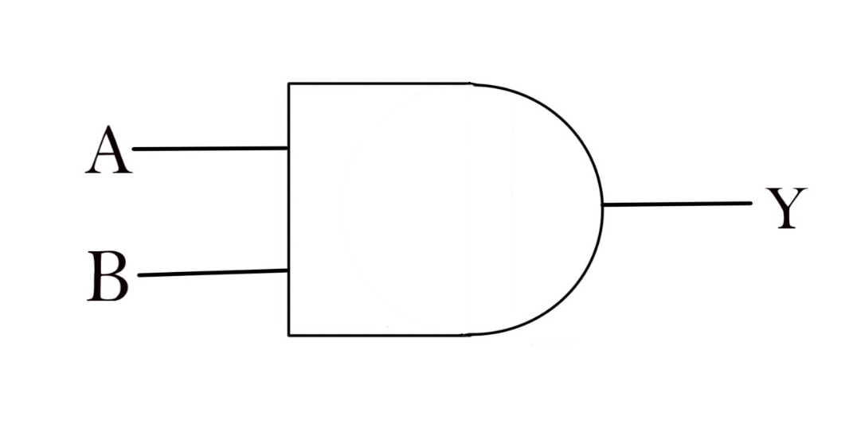
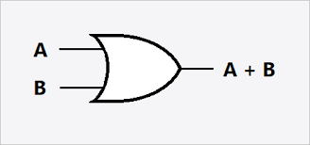
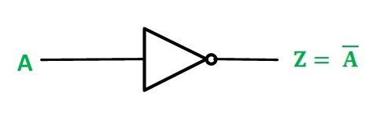
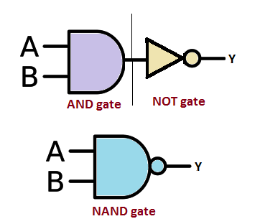
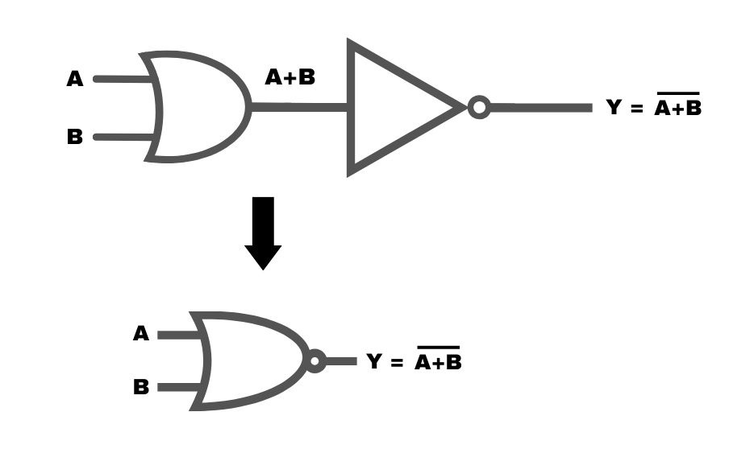
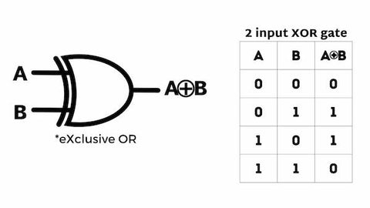

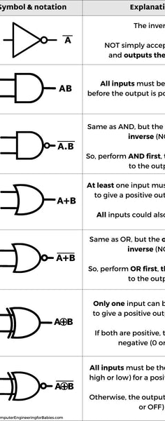
Building Blocks: Logic Gates
AND gate symbol
OR gate symbol
NOT gate symbol
NAND gate symbol
NOR gate symbol
XOR gate symbol
XNOR gate symbol
Logic gate circuit
The AND gate outputs 1 only if both inputs are 1, otherwise outputs 0.
The OR gate outputs 1 if one or both inputs are 1, otherwise outputs 0.
The NOT gate outputs the opposite of its single input.
The NAND gate outputs the opposite of the AND gate.
The NOR gate outputs the opposite of the OR gate.
The XOR gate outputs 1 if inputs differ, otherwise outputs 0.
The XNOR gate outputs the opposite of the XOR gate.
A simple logic gate circuit combining AND, OR, and NOT gates.

Slide 4
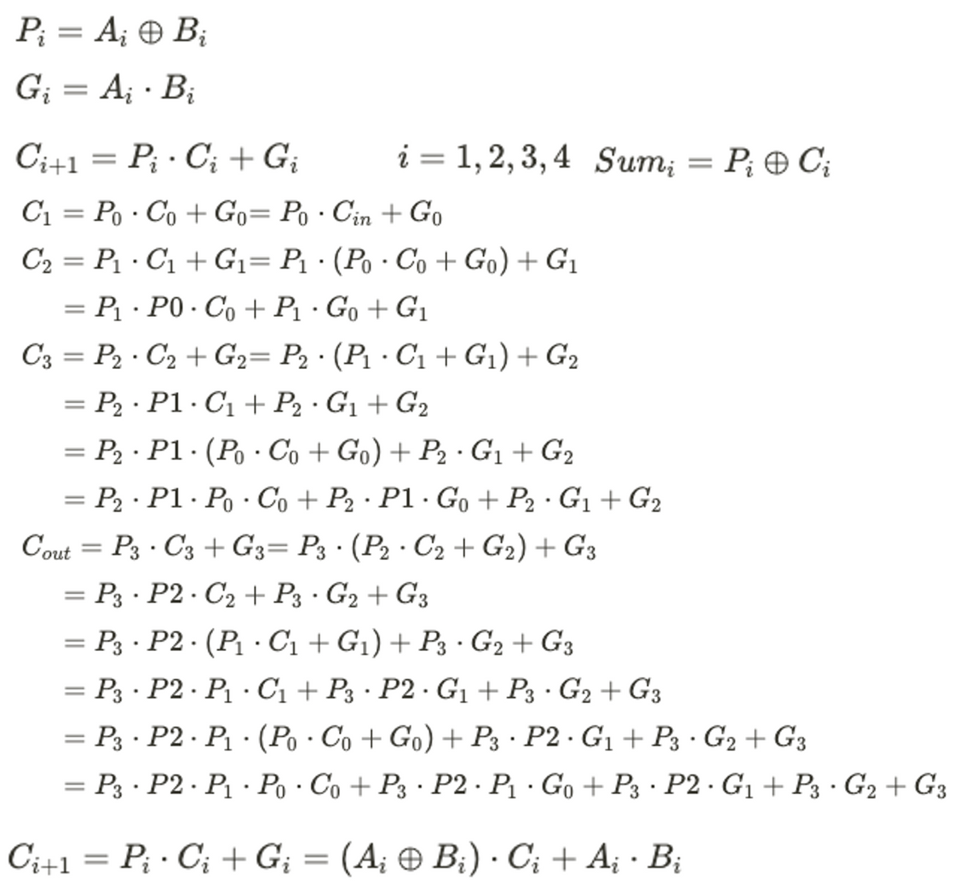

Slide 5

A Look Inside: Electric VLSI
VLSI (Very Large Scale Integration) enables complex digital circuits by packing millions of transistors onto a single integrated circuit chip. This high level of integration allows for greater functionality and performance. The carry lookahead adder explored in this presentation takes advantage of VLSI to quickly perform 4-bit addition in a single clock cycle.

Slide 6
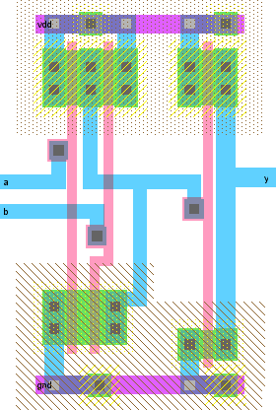

Slide 7

CLA
carry lookahead adder
image generated by Gemini.

Slide 8
Introducing the Carry Lookahead Adder
What is a Carry Lookahead Adder?
How Does it Work?
Advantages Over Ripple Carry
A CLA uses propagate and generate signals to determine carries before the sum.
A CLA calculates carries ahead of time to overcome limitations of ripple carry adders.
Faster computation by reducing wait time for carries to ripple through each full adder.
Implementation
Applications
Challenges
CLAs can be implemented with basic logic gates like AND, OR, and Inverters.
Used in CPUs and other digital circuits needing fast addition.
More complex logic and circuitry than ripple carry adders.

Slide 9
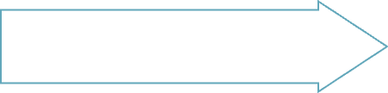
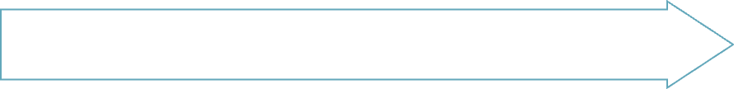
Demystifying P and G Signals
P signals allow carry-in propagation
G signals enable carry generation
Reduces carry delay by carry lookahead
Faster operation due to reduced carry delay

Slide 10



Benefits and Applications
Faster clock speeds for CPUs
Lower latency for operations
Faster processing
Since the CLA performs carry propagation faster, it enables CPUs to operate at higher clock frequencies.
The CLA reduces the latency for arithmetic logic unit (ALU) operations involving carries.
By reducing operation latency, the CLA boosts overall processing speed for applications like video encoding, 3D rendering, scientific computing, etc.
The 4-bit carry lookahead adder enables higher CPU clock speeds and faster processing for compute-intensive applications by accelerating carry propagation.

Slide 11
Where..?
CPUs (Central Processing Unit)
The ALU (arithmetic logic unit )in CPUs uses CLAs to speed up addition, subtraction, etc.
DSPs (Digital Signal Processors)
CLAs improve speed and efficiency of addition/multiplication in DSPs
Cryptography
HPCs (High-performance computing)
Supercomputers use CLAs for fast scientific/engineering computations
CLAs assist in error correction
for fast encoding/decoding

Slide 12

Conclusion
The 4-bit carry lookahead adder allows for faster addition by pre-computing the carry bits. This enables all the sum bits to be calculated in parallel, significantly speeding up the addition operation. The key takeaways are that carry lookahead reduces delay by avoiding rippling carries, and parallelizes the addition process by calculating multiple sums simultaneously.

